Slide 1
Online Gift Registry
Team TEENG
Tai Butler, Edward Martinez, Eduardo Davila, Nupoor Basmatkar, Graham O’Hea

Slide 2
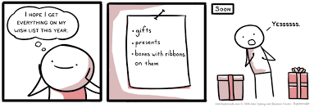
Project Vision
A lifetime of gifting made easy
Users will be able to create wish lists
Gift givers will be able to give the perfect gift
(Culang & Castro, 2008)

Slide 3
Project Scope
Web app and database
Online hosting
Users can create accounts and wish lists
Users will be able to make connections with each other
Gift givers can collaborate on gifts to give
The recipient will not be able to see gifts that have been selected

Slide 4
V-Model
Develop Requirements
Validation
Traceability
Documentation
Develop Project Design
User Acceptance
Testing
Validation
Traceability
Develop Implementation Plan
Develop Compliance Docs
Develop Workflows and Use Cases
Testing
Conduct Marketing Analysis
Write Code and Deployment
Develop User Interface Design

Slide 5
Workplan Estimates - Design
Requirements – 16 work hours
Database design – 16 work hours
Workflow mapping – 12 work hours
Interface design – 20 work hours
Marketing research – 40 work hours
Cost analysis – 4 work hours

Slide 6
Workplan Estimates – Implementation
Database construction – 4 work hours
Web development – 250 work hours
Deployment – 8 work hours
Testing – 150 work hours
Compliance – 12 work hours

Slide 7
Workplan Estimates - Overhead
Familiarization with development methodologies – 8 hours
Learning programming skills – 60 hours

Slide 8
Team TEENG
Tai Butler – visual design, graphics, and marketing research and analysis
Edward Martinez – project management and infrastructure
Eduardo Davila – associate software development
Nupoor Basmatkar – risk analysis and management, compliance, and quality assurance
Graham O’Hea – team lead, project design, and principle software development

Slide 9
High-Level Project Timeline
 | Week
Task | 1 | 2 | 3 | 4 | 5 | 6 | 7 | 8 | 9 | 10 | 11 | 12
Develop requirements
Develop project design
Develop implementation plan
Develop workflows and use cases
Conduct marketing analysis
Develop user interface design
Write code and deployment
Testing
Develop compliance docs

Slide 10
Specific Tasks
Conducting social media analysis
Development of the user interface wireframes
Development of custom graphics as needed
Creating the overall website structure
Writing the actual code
Deployment to the hosting environment
Development of testing framework
Testing deployed web app
Research regulatory requirements and develop compliance needed for it
Documentation of the business case for this project
Development of the use cases for this platform
Development of user workflows
Conducting functional requirements analysis
Conducting technical requirements analysis
Selection of database, web server, and development framework
Selection of the hosting environment
Development of the project plan
Conducting general market analysis

Slide 11
Costs – Estimates and Actuals
Expense | Estimate | Actual | Difference
Salaries per team member (pro-rated to 3 months) | $100,000 (simulated) | $100,000 (simulated) | $0
Hosting costs | $100.00 | Domain name: $14.99 x 2 DNS costs: $2.00 Tech Support: $38.42 Total: $70.40 | $29.60 (under budget)
Graphic design | $200.00 | $65.00 | $135.00 (under budget)

Slide 12
Marketing Strategy
Marketing vision
Market analysis
Marketing initiatives
Email campaign
Social media
Target markets
Online gift registries
Event planning
Buyer personas
Product, place, promotion, and price
Marketing channels

Slide 13

Branding
Hired graphic designer
They helped us to develop our brand personality
Collaborated with them to create logo

Slide 14
Risk Analysis
Description | Likelihood | Potential loss | Early Warning | Abatement
Scope creep – the features of the project extend beyond requirements | Medium | High | Missing milestones | Sticking to establish design plans and culling any features beyond the minimum viable product
Scheduling issues | Low | High | Unable to keep project plan | Redefine the tasks in the project along the critical path
Cost overruns | Medium | High | Costs are higher than expected | Reduce or eliminate non-necessary expenditures
Loss of stakeholder satisfaction | Low | High | Expression of dissatisfaction | Keeping stakeholders informed and addressing concerns immediately
Change in the market | Medium | High | Watching trends | Adjusting marketing strategy based on trends

Slide 15
Problem Analysis
Scheduling conflicts among team members
Coordination of multiple tasks over the course of the schedule

Slide 16
System Context

Slide 17
Product Use Cases

Slide 18
Functional Specifications
User functions
Events
Wish lists / registries
Interests
Connections
Connection requests
Items
Item Indications

Slide 19
Functional Specifications Excerpts
“The user should be able to indicate dates and holidays that are important to them. These dates can be a one-time event, such as a graduation or wedding, or they can be recurring events, such as birthdays, anniversaries, and holidays. For phase 1, recurring events only have to happen once a year.”
“Users should be able to browse through the platform to find other users of the service that they might know. If they do find someone that they know, they should be able to send a request to that person. The second person should be able to approve the request and indicate the relationship that they have with the requesting person. This is known as a Connection.”
“When a user adds a new item to their wish list, they will be required to assign that item one or more connection levels to indicate the comfort that they have with connections in that particular level seeing the item that they have added.”

Slide 20
Requirements Traceability Matrix Excerpt
Page Structure (Header/Footer)
1.1. Every header will display the company logo that redirects to the site homepage.
1.2. Every footer will display links to the company’s social media sites.
1.3. Every footer will display the “Terms and Conditions”.
1.4. Every footer will display the “Privacy Policy”.
1.5. Every footer will display a “Contact us” link that will include an email address for users to use when reaching back to the company.

Slide 21
Test Case Examples
Test Case # | Action | Expected result | Test Result
1 | Click on the logo in the header. | The user is redirected to the homepage.
2 | Click on the social media site links. | The user is redirected to the company’s social media account pages.
3 | Click on the “Terms and Conditions” link. | The “Terms and Conditions” are displayed.
4 | Click on the “Privacy Policy” | The “Privacy Policy” is displayed.
5 | Click on the “Contact Us” link | The company’s email will display for the user.

Slide 22
Non-Function Specifications Excerpts
Security
Audit
Performance
Availability
Recovery
Compatibility
Maintainability
Usability
Localization
“The system will be primarily written in PHP using commonly available development tools and frameworks. Where possible, the system should be designed that expects future changes to the underlying system and can accommodate new changes as they become known in as clean of a manner as possible.”

Slide 23
Sitemap

Slide 24
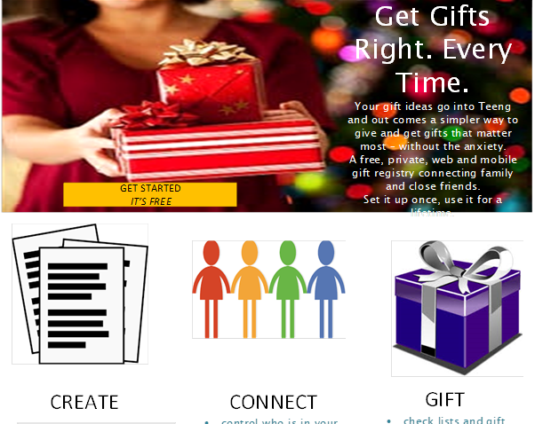
System Interface – Home Page

Slide 25
Entity Relationship Diagram

Slide 26
Database Tables

Slide 27
Risk Management Process
Identifying risks
Analyzing risks
Prioritizing risk
Assigning risk ownership
Responding to risks
Monitoring risks

Slide 28
Risk Register
ID | RISK | Identified By | Mitigation Strategy | Likelihood | Impact | Detection Difficulty
1 | Scope creep | Team | Sticking to establish design plans and culling any features beyond the minimum viable product | Medium – 3 | High – 5 | Low - 1
2 | Scheduling issues | Team | Redefine the tasks in the project along the crticial path | Low – 1 | High – 4 | Low - 1
3 | Cost Overruns | Team | Reduce or eliminate non-necessary expenditures | Medium – 2 | High – 5 | Low - 1
4 | Loss of stakeholder satisfaction | Team | Keeping stakeholders informed and addressing concerns immediately | Low – 1 | High - 5 | Low - 2
5 | Change in the market | Team | Adjusting marketing strategies based on current trends | Medium – 3 | High – 4 | Medium - 3
6 | Breaches in security | Nupoor | State of the art security along with trustworthy backups | High – 4 | High – 5 | Medium - 3
7 | Catastrophic loss | Graham | Having good backup and clean-up strategy | Low - 1 | High - 4 | Low - 2

Slide 29
Risk Contingency Plan
Risk Event | Response | Contingency Plan | Trigger | Responsible Party
Not sticking to establish design plans and culling any features beyond the minimum viable product | Immediate refocus | Circle back to initial Project Scope and recognize what needs to be done and what is becoming a scope creep factor and needs to be stopped. | Unmapped/unscheduled additions to project implementation | Team
Accumulating non-necessary expenditures | Reduce | Cross-check financials and ensure any unnecessary expenses are immediately curtailed. | Over-spending | Team
Not keeping stakeholders informed and addressing concerns immediately | Immediate refocus | Call a meeting with stakeholders and entire team to work on any concerns | Any concerns voiced by Stakeholders | Team
Not Adjusting marketing strategies based on current trends | Reduce | Marketing team must make sure we are up to date in terms of our consumers’ needs and the current market | Competitors doing better than us in terms of customer base and revenue | Tai
Not having state of the art security along with trustworthy backups | Reduce | Security team should update all security requirements in order to ensure all data is safe and backed up | Any data leaks or cybercrime activity | Nupoor
Not having good backup and clean-up strategy | Immediate refocus | Backup strategy must be revamped and all clean-up strategies should eb revisited to ensure best customer satisfaction | Unhappy customers | Nupoor

Slide 30
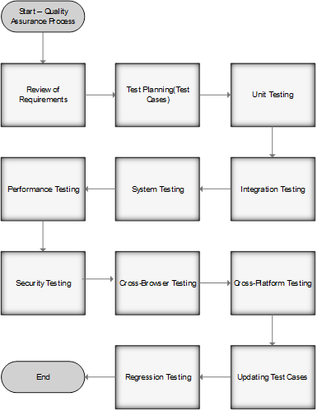
Quality Assurance Process
Analysis of requirements
Design
Implementation
Verification or testing
Maintenance

Slide 31
System Testing
Function testing
Links testing
Forms testing
Cookies testing
HTML/CSS validation
Usability testing
Content testing
Interface testing

Slide 32
Change Management Process
Identify the need for a change (Any Stakeholder)
Log change in the change request register (Project Manager)
Conduct an evaluation of the change (Project Manager, Project Team, Requestor)
Submit change request to Stakeholders (Project Manager)
The Stakeholders Decision
Implement Change (Project Manager)

Slide 33
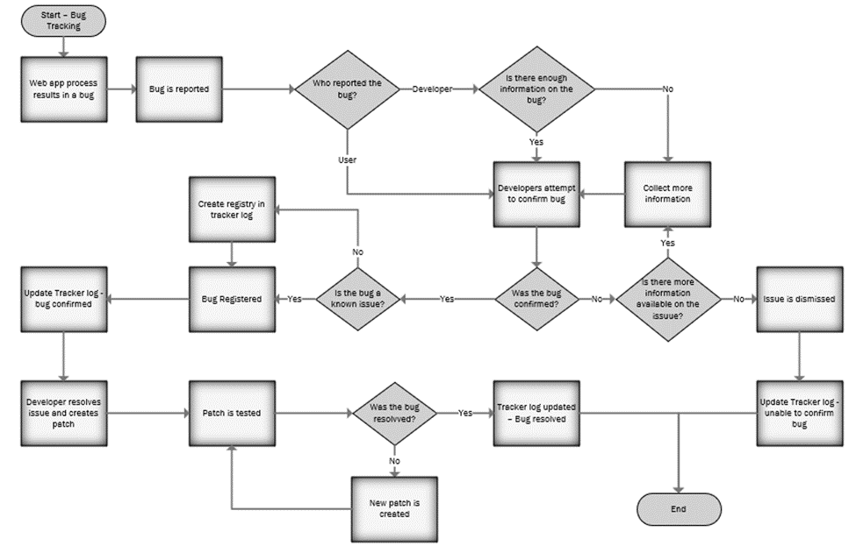
Defect Reporting Process

Slide 34
Issue Priorities
Critical: The trunk does not work. Significant parts of the source are broken preventing key operations.
Urgent: Portions of the source are hindering advertised functions in a major way.
Medium: Issues are hindering proper function but applications are still working. There are workarounds for the issues.
Low: There is a minor loss of advertised function. Typically, this is just a nuisance but does not significantly affect proper function of the site. This may be a result of the site being accessed from an uncommon platform.
Very low: These issues are related to cosmetics, misspellings, misaligned graphics, etc.

Slide 35
Defect Tracking Log
DEFECT TRACKING LOG
Webpage name: TEENG Registry
Webpage URL: https://teeng.net
Purpose: To ensure that web site meets intended performance specifications. This spreadsheet will be used to track defects. The goal is to find the majority of the site's bugs before going live but there will always be things that are missed. This log will be used to document and test defects that must be corrected after project completion. This form will make it easier to monitor the progress of bug corrections. This form may be used by any member of the team.
Issue No. | Creation date | Logged by | Description | Priority | Assigned Date | Estimated time to resolve | Status | Resolution | Resolution Date | Actual Time to Fix | Root Cause
1
2
3
4
5
6
7
8
9
10

Slide 36
Task Name | Duration | Start | Finish
Team TEENG Gift Registry | 70 days | Mon 10/29/18 | Sat 2/2/19
Develop Requirements | 14 days | Mon 10/29/18 | Thu 11/15/18
Documentation of Business Case | 8 days | Thu 11/1/18 | Sun 11/11/18
Presentation | 0 days | Tue 11/6/18 | Tue 11/6/18
Milestone 1/ Documentation | 0 days | Thu 11/8/18 | Thu 11/8/18
Develop Project Design | 9 days | Mon 11/5/18 | Thu 11/15/18
Develop Implementation Plan | 14 days | Mon 11/12/18 | Thu 11/29/18
Develop Risk Management Process | 12 days | Tue 11/13/18 | Wed 11/28/18
Develop Quality Assurance Processes | 5 days | Tue 11/13/18 | Mon 11/19/18
Develop a Defect Tracking Process | 5 days | Wed 11/14/18 | Tue 11/20/18
Develop a Change Management Process | 5 days | Wed 11/14/18 | Tue 11/20/18
Develop Workflows and Use Cases | 6 days | Mon 11/5/18 | Sun 11/11/18
Milestone 2/Documentation | 0 days | Mon 11/19/18 | Mon 11/19/18
Presentation w/Demo | 0 days | Tue 11/20/18 | Tue 11/20/18
Milestone 1&2 Revision and Documentation | 0 days | Sat 11/24/18 | Sat 11/24/18
Presentation PPT | 0 days | Sat 11/24/18 | Sat 11/24/18
Conduct Marketing Analysis | 20 days | Mon 11/5/18 | Fri 11/30/18
Conduct Social Media Analysis
Conduct Functional Requirements Analysis | 8 days | Thu 11/1/18 | Sun 11/11/18
Conduct Technical Requirements Analysis
Task Name | Duration | Start | Finish
Selection of database, web server, and development framework | 3 days | Mon 11/12/18 | Wed 11/14/18
Selection of Hosting Environment | 3 days | Thu 11/15/18 | Sat 11/17/18
Development of user interface wireframes | 8 days | Thu 11/15/18 | Sat 11/24/18
Write Code and Deployment | 36 days | Mon 11/26/18 | Sun 1/13/19
Development of custom graphics | 26 days | Mon 11/26/18 | Mon 12/31/18
Create overall website structure
Deployment to the hosting environment
Testing | 40 days | Mon 12/3/18 | Fri 1/25/19
Test Deployment and Web App
Update ERD | 4 days | Thu 11/29/18 | Tue 12/4/18
Develop Site Map | 4 days | Thu 11/29/18 | Tue 12/4/18
Milestone 3 Documentation/ Presentation | 0 days | Wed 12/5/18 | Wed 12/5/18
Milestone 3 Revision | 0 days | Mon 12/10/18 | Mon 12/10/18
Milestone 4 | 0 days | Wed 12/19/18 | Wed 12/19/18
Milestone 4 Revision | 0 days | Sat 12/22/18 | Sat 12/22/18
Develop Compliance Docs | 22 days | Fri 12/14/18 | Sat 1/12/19
Research Regulatory Requirements and Develop Compliance
Milestone 5 | 0 days | Wed 1/16/19 | Wed 1/16/19
Milestone 5 Revision | 0 days | Mon 1/21/19 | Mon 1/21/19
Final Presentation | 0 days | Wed 1/30/19 | Wed 1/30/19
Final Version of Documentation and PPT | 0 days | Sat 2/2/19 | Sat 2/2/19

Slide 37
Communication Plan
Communication Type | Description | Frequency | Format | Participants/Distribution | Deliverable | Owner
Status Report | Project Status | Weekly | Email/Zoom | Project Team | Update Docs | Project Manager
Team Meeting | Collaboration Meetings | Weekly | Email/Zoom | Project Team | Update Team | Project Manager
Project Review | Present project status to Stakeholders | Weekly | Email/Zoom | Project Team | Project Team | Project Manager
Milestones | Maintain project scope to meet milestone dates | Weekly | Email/Zoom | Project Team | Phase completion and kickoff report | Project Manager
Design Review | Collaboration on Design/Analysis | Weekly | Email/Zoom | Project Team | Design Package | Project Manager

Slide 38
Policy Development
Terms and Conditions
Privacy Policy
Cookie Policies

Slide 39
Meeting Minutes
Team TEENG
Gift Registry Project
Meeting Minutes
Date: November 29, 2018
Start Time: 6:30pm
Attendees: Tai Butler, Edward Martinez, Eduardo Davila, Nupoor Basmatkar, Graham O’Hea
AGENDA
Call to Order
Approval of Minutes
Team approved
Unfinished Business

Slide 40
Usability Testing
Task 1 – Navigate to the website’s Sign-up page and create an account.
Task 2 – Navigate to the website’s Homepage and login in.
Task 3 – Navigate to your event’s page and create an event.
Task 4 – Navigate to your Wish List’s page and create a wish list.
Task 5 – Navigate to one of your wish lists and add an item.
Task 6 – Navigate to your connections page and add one of the team members.
Task 7 – Navigate to your wish list created and hide the item you added in task 5.

Slide 41
Technical Details
Hosting through AWS
Elastic Beanstalk
RDS
Route 53
CodeCommit
VPC
Development
Apache
MySQL
Eclipse PHP
Bootstrap
Written in PHP, SQL, HTML, JavaScript, CSS
5,265 lines of code

Slide 42
Demo
http://www.teeng.org/Home/

Slide 43
Lessons Learned
Success will only be possible if we work together as a team
A project of this size has numerous interdependencies that all have to be accounted for
Time management is of the upmost importance
Just how much of the content that we have learned in other classes has come into play in the course of this project
Chen’s Notation ERD and table mapping

Slide 44
References
Culang, A. & Castro, R. (2008, Dec 25). Wish-list. Retrieved from http://buttersafe.com/2008/12/25/wish-list/

